Slide 1
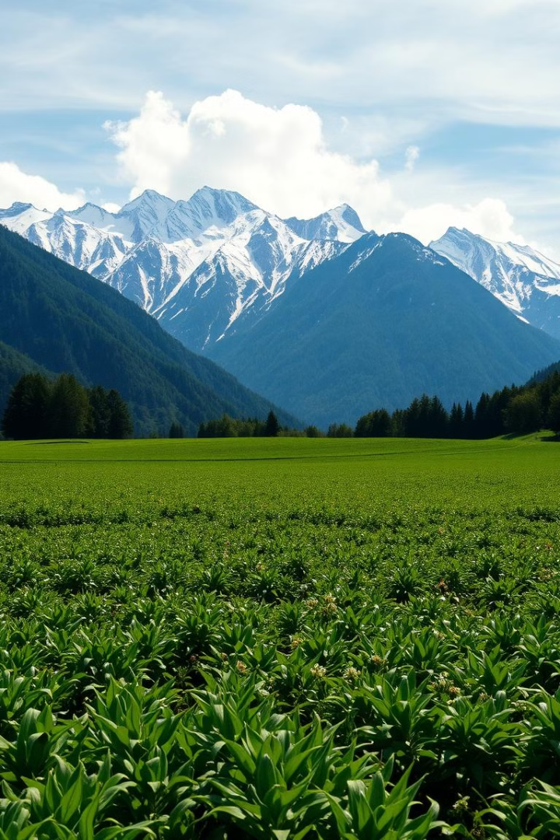

AI-Powered Agricultural Land Disease Detection for Gilgit-Baltistan
Gilgit-Baltistan, a region in northern Pakistan, is renowned for its rich agricultural heritage. However, the region faces a significant challenge in the form of land diseases that can devastate crop yields and threaten food security. This presentation will explore an innovative AI-driven model that aims to address this critical issue, empowering local farmers and communities through timely disease detection and comprehensive guidance.
by Kashan Baig

Slide 2
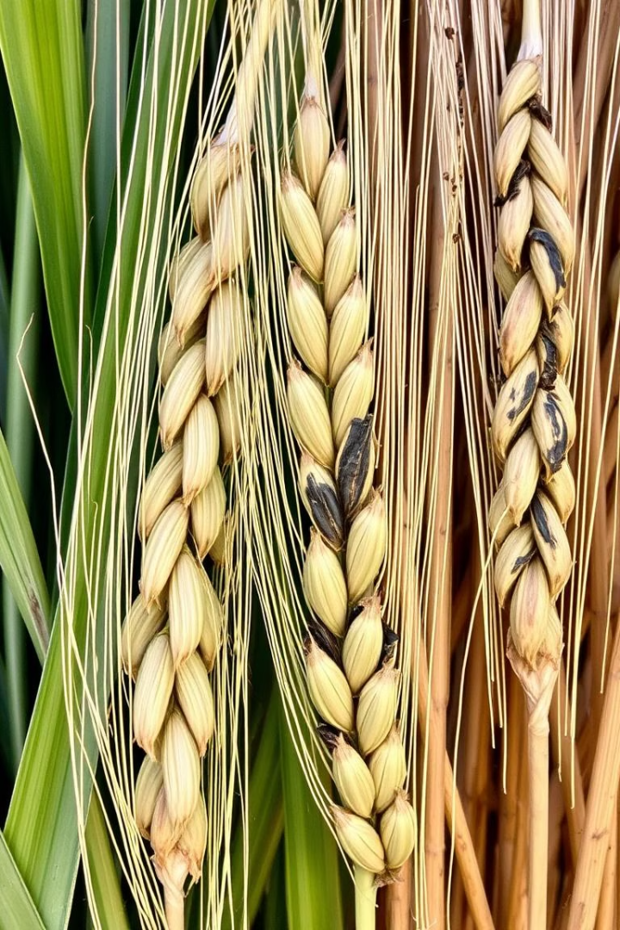
Safeguarding Gilgit-Baltistan's Agricultural Heartland
1
Agricultural Significance
2
Common Land Diseases
Gilgit-Baltistan is a prominent agricultural hub, known for its diverse crop cultivation, including wheat, maize, fruits, and vegetables. The region's fertile land and favorable climate make it a vital contributor to Pakistan's food security.
The region faces a range of land diseases, such as fungal infections, bacterial blights, and soil-borne pathogens, which can drastically reduce crop yields and quality if left undetected and untreated.
3
Adverse Impacts
Undiagnosed or untreated land diseases can lead to significant economic losses for farmers, as well as broader food security challenges for local communities and the nation as a whole.

Slide 3
Empowering Farmers through AI-Driven Disease Detection
The Challenge
The Proposed Solution
Key Features
Farmers in Gilgit-Baltistan often lack access to timely disease diagnosis and effective treatment options, leading to ongoing crop losses and diminished livelihoods.
An AI-driven alert system that can quickly and accurately detect land diseases, provide guidance on recommended solutions, and deliver timely notifications to farmers, empowering them to take proactive measures.
Disease awareness campaigns to educate farmers
Automated disease detection and alert generation
Guidance on appropriate treatment options and recommended medicines

Slide 4

Harnessing the Power of AI for Agricultural Land Health
1
Disease Detection
The model utilizes advanced AI and image processing algorithms to analyze images of crops and soil, identifying the presence and types of land diseases with a high degree of accuracy.
2
Alert Generation
Upon detection of a disease, the system generates timely alerts, notifying farmers and relevant authorities, enabling them to take immediate action to mitigate the impact.
3
Solution Guidance
The model provides detailed recommendations on effective treatment solutions, including the most suitable medicines and best practices for disease management, empowering farmers to address the issue effectively.

Slide 5
How AI Models Work in Agriculture
1
Data Collection and Preprocessing
2
Deep Learning Architectures
AI models in agriculture rely on large, diverse datasets of labeled images, weather data, and other relevant information. This data is carefully preprocessed and standardized to ensure optimal model performance.
Convolutional Neural Networks (CNNs) are a popular deep learning technique used for image classification tasks in agriculture, such as identifying pests and diseases in crops. These models can extract and learn complex visual features from the input data.
3
Transfer Learning
4
Model Deployment and Optimization
To leverage existing knowledge and accelerate model training, researchers often use transfer learning techniques. This involves using pre-trained models, such as those developed for general image recognition, and fine-tuning them on agriculture-specific datasets.
After thorough testing and validation, the trained AI models can be integrated into various agricultural technologies, such as drones, satellites, and smart farming systems. Ongoing monitoring and optimization ensure that the models maintain high accuracy and performance in real-world conditions.

Slide 6
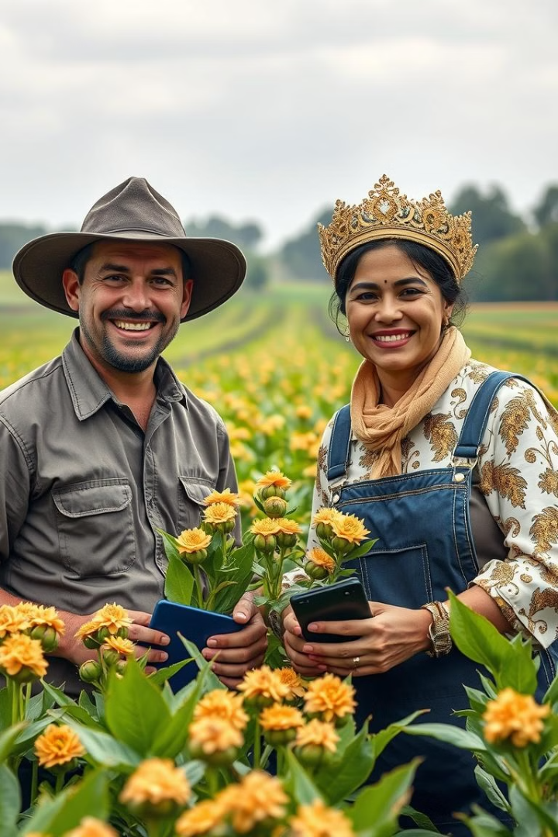
Transforming Gilgit-Baltistan's Agricultural Landscape
Benefits for Farmers
Community Empowerment
The AI-driven model helps farmers in Gilgit-Baltistan improve their crop yields, reduce losses, and optimize their farming practices, leading to increased income and food security for their families and communities.
By providing farmers with cutting-edge technology and disease management knowledge, the model empowers local communities, fostering a culture of self-reliance, innovation, and sustainable agricultural development.
Scalable Impact
The success of the model in Gilgit-Baltistan paves the way for its expansion to other agricultural regions, sharing the benefits of this transformative technology and positively impacting the lives of farmers across Pakistan.

Slide 7




Towards a Resilient and Sustainable Agricultural Future
Weather Predictions
Integrating weather forecasting data to enhance the model's capabilities, enabling farmers to make informed decisions and better prepare for adverse climatic conditions.
Soil Health Monitoring
Incorporating soil health analysis to provide farmers with a holistic view of their land's conditions, allowing them to implement targeted interventions and maintain sustainable soil fertility.
Scalable Growth
Expanding the model's reach to other regions, ensuring that the benefits of this AI-powered solution are shared with farmers across Pakistan, contributing to the overall resilience and sustainability of the nation's agricultural sector.

Slide 8
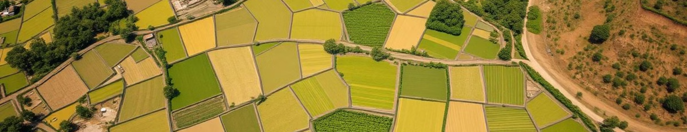
Securing a Brighter Agricultural Future for Gilgit-Baltistan
The AI-driven model for agricultural land disease detection in Gilgit-Baltistan represents a transformative solution that empowers local farmers, strengthens food security, and paves the way for a more resilient and sustainable agricultural future. By combining cutting-edge technology, data-driven insights, and community-centric approach, this model has the potential to revolutionize the way farmers in the region manage and protect their most valuable asset – their land. As the model continues to evolve and expand, it will play a pivotal role in securing the long-term prosperity and self-sufficiency of Gilgit-Baltistan's agricultural communities.

